Slide 1

Seat planner

Slide 2
Introduction
Seat planner is the automatic seat allocating software for examination.
It selects examinee randomly from database, allocates a seat and generate report in excel.

Slide 3
Problem of Existing System
Repetition of Examinee
Forgot to allocate seat for examinee
Needs lots of time and effort

Slide 4
Objectives
To develop a system for examiner to add examinee and generate automatic seat plan for exams in excel file.
To reduce time and effort for examiner to make seat plan
To solve problem of manual Seat planning such as repetition of examinee and no seat for examinee.

Slide 5
Developed System
This system is used for generating seat plan report automatically.
System operation:
Authentication for user
Add, delete, update student and room
Generate Seat plan
Change password for user
View generated file

Slide 6

Use Case Diagram

Slide 7
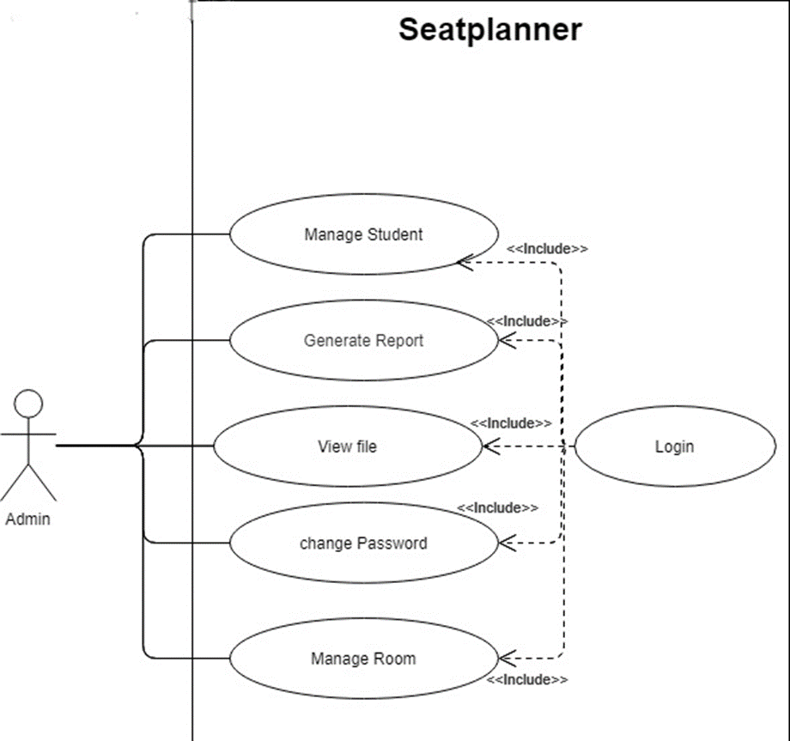

Slide 8

Context LEVEL Diagram(level 0 DFD)

Slide 9
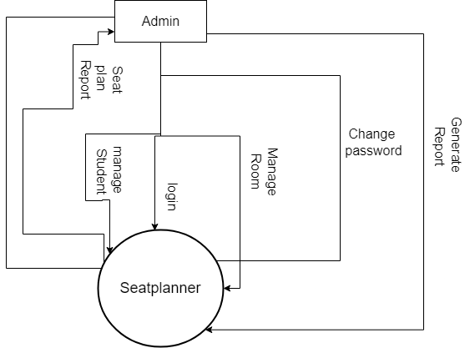

Slide 10

Level 1 Data Flow Diagram

Slide 11
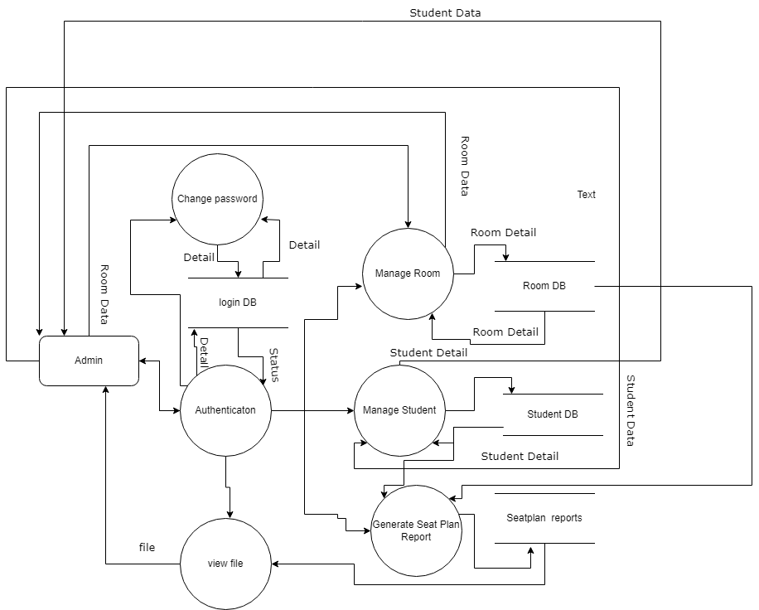

Slide 12

ER Diagram

Slide 13
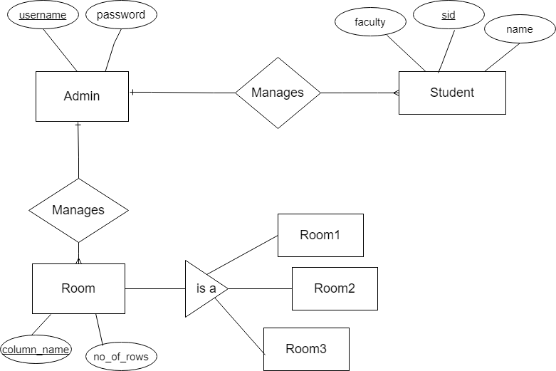

Slide 14
Tool Used
IntelliJ Idea IDE for java
XAMPP for MySQL and server
DBforge mysql studio for dummy data

Slide 15
Limitations
No feature added for elective courses
You cannot update room name and no of column.
If selected room exceeds no of student, then also new sheet will be created in the excel file.
No record of student in which room, seat is allocated for them.

Slide 16
Conclusion
The project 'Seat planner' is use for computerizing seat plan generation for exams.
This project includes all the activity related to seat plan generation.
This Project results in reduction of manpower & workload on staff.
This project benefits all the educational institutes by reducing the complexity involved while allocating examination rooms for the students

Slide 17


